Slide 1
Business Intelligence and Data Warehousing
A guide to prospective Students.
BY:
Samuel OCEN.
Lecturer Computer Science - MMU

Slide 2
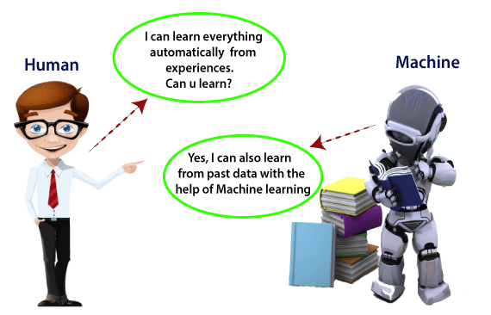
Introduction
The functional process of the brain with the help of Neurons make us capable of learning any complex Work.
With data being collected and saved, learning is capable of taking shape.
During exposure to anything, the brain relates to what it had learnt and gives back feedback.

Slide 3
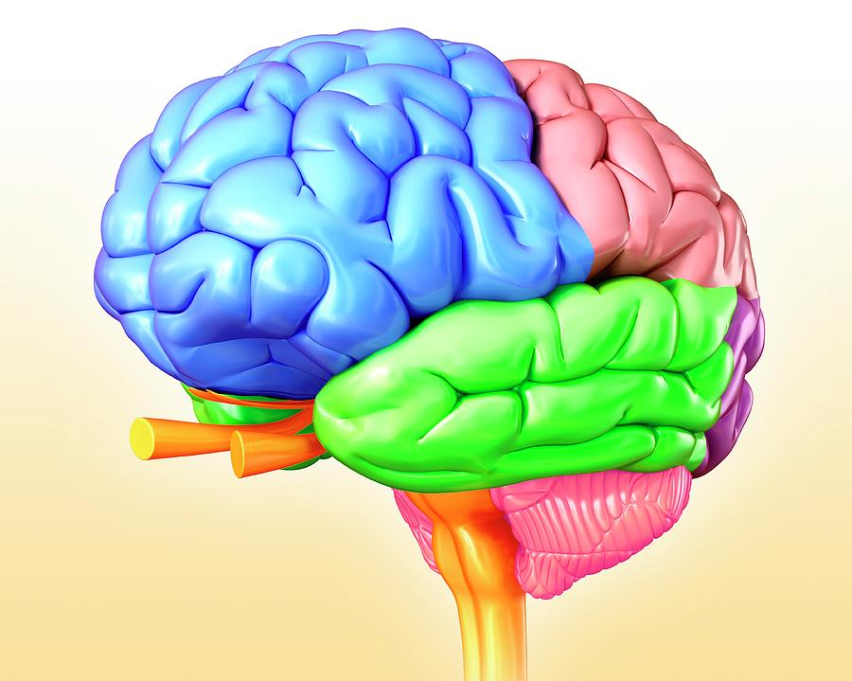
Data Warehousing Concept
Various partitions of the brain work for different functions, but each contribute to the final goal.
I would relate this several partitions of the human brain to various database components.
The human brain with vast compartments relate to what the main data warehouse was formed.

Slide 4
Difference between a Data Warehouse and a Database
Attributes
Database
Data Warehouse
Workloads
Data Type
Schema Flexibility
Data Freshness
Users
Operational and transactional.
Structured and semi structured.
Rigid or flexible schema depending on database type.
Real time.
Application Developers.
Analytical
Structured and or Semi-Structured.
Pre-defined and fixed schema definition for ingest (schema on write and read).
May not be up-to-date based on frequency of ETL processes.
Business analysts and data scientists.

Slide 5
Approach
We will identify sectors which need data warehouses in our community.
Design a concept for that specific sector with full ERD diagrams.
Implement Data Warehouse for it.
Query data from it.
Implement a basic model to help in prediction of the potential outcome.

